Slide 1

Enabling True Few-Shot Generalization in Recursive Reasoning Models for ARC-AGI
A Demonstration Encoder Approach
Baris Deniz Saglam
MMI-714 Generative Models for Multimedia

Slide 2
TLDR
A variational encoder that processes input-output demonstrations to produce task context vectors,
replacing the task-specific learned embeddings in TRM/HRM and
enabling these recursive reasoning models to generalize to unseen ARC-AGI tasks

Slide 3
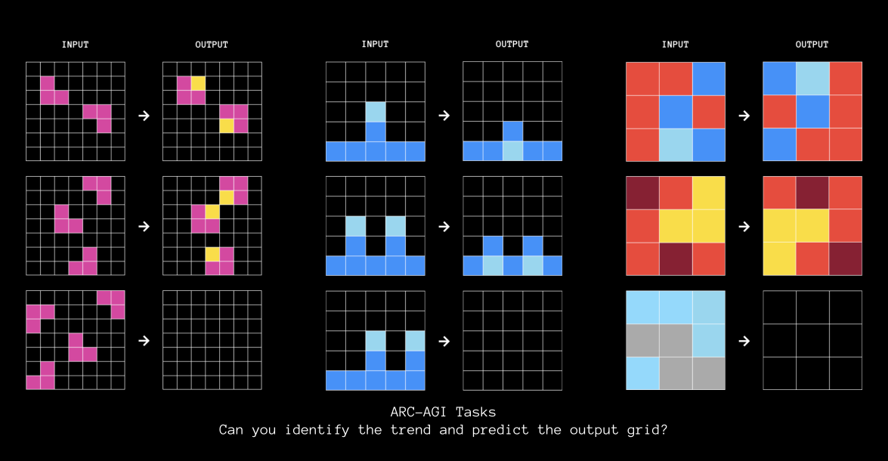
Try yourself at https://arcprize.org/play

Slide 4
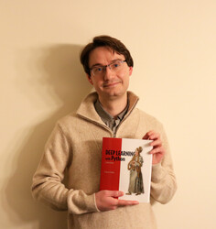
Also creator of Keras
What is ARC-AGI?
The Abstraction and Reasoning Corpus
Introduced by Francois Chollet (2019) to measure "fluid intelligence"
Chollet's View on Intelligence
Intelligence is not skill at any task, but
skill-acquisition efficiency—learning new skills
quickly from minimal experience.
“The measure of intelligence is the efficiency with which a learner turns experience and priors into skill at new tasks.”
2D grid puzzles with colored cells (up to 30x30, 10 colors)
Each task: 2-5 demonstration pairs showing input to output
Goal: Infer the transformation rule, apply to test input
Every task is completely unique
Key: Tasks cannot be anticipated during training
Source: Chollet, F. (2019). "On the Measure of Intelligence" https://arxiv.org/abs/1911.01547

Slide 5
Why ARC-AGI Matters
The "Most Important Unsolved AI Benchmark"
85%+
Tests generalization to truly novel problems
Requires "core knowledge" humans have: objects, counting, symmetry
Cannot be solved by pattern recall or memorization
Considered a key milestone toward AGI
Human Accuracy
~55%
Best AI (2024)
"ARC is adversarially diverse - methods that work for one class of tasks fail for others"
0%
GPT-3 (2020)

Slide 6
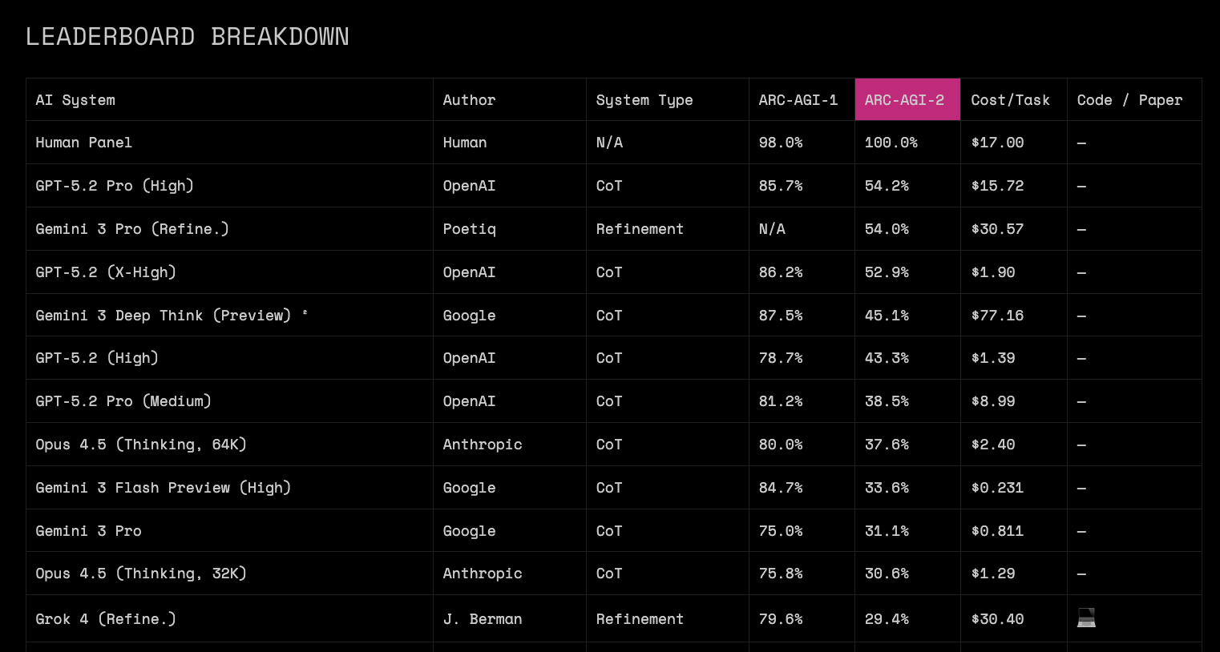
Source: https://arcprize.org/leaderboard
Notes:
That green line is new pareto frontier by Gemini-3 Flash (announced 2 days ago)

Slide 7
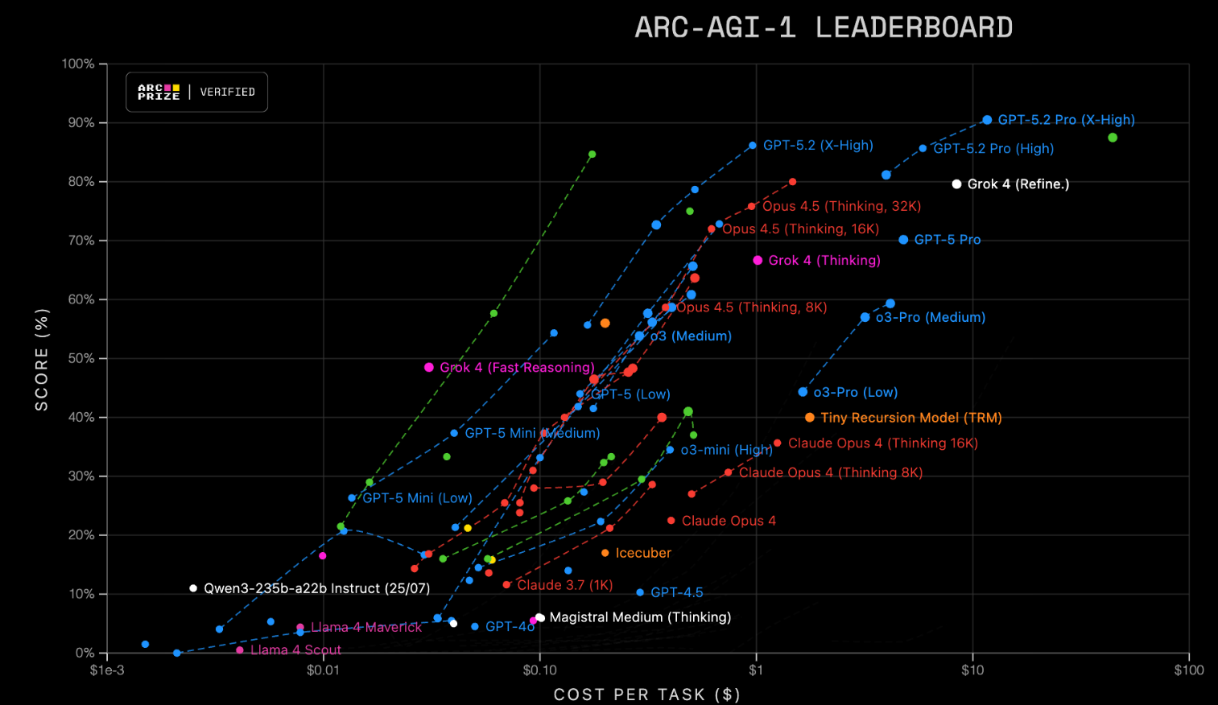
Source: https://arcprize.org/leaderboard
Notes:
That green line is new pareto frontier by Gemini-3 Flash (announced 2 days ago)

Slide 8
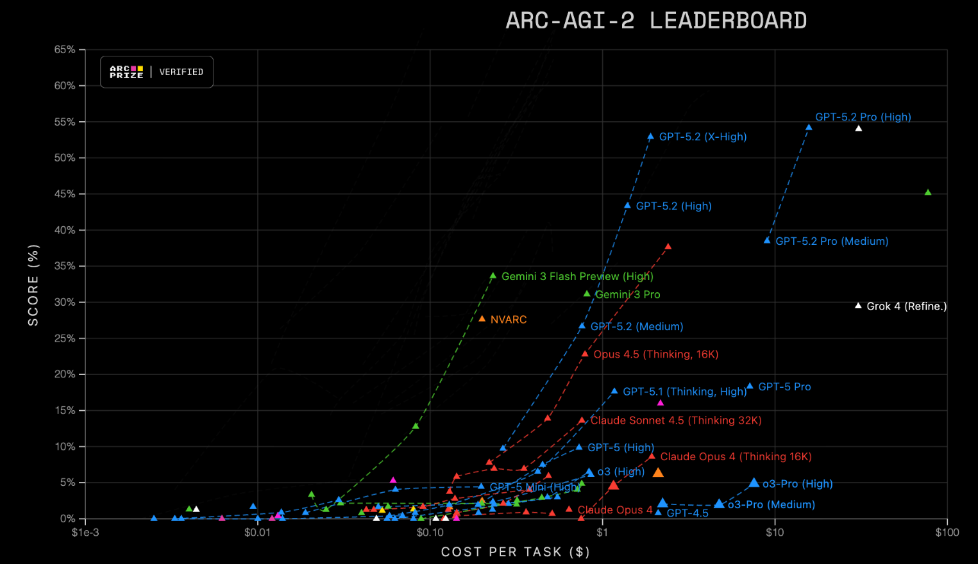
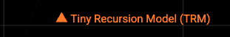
Source: https://arcprize.org/leaderboard
Notes:
That green line is new pareto frontier by Gemini-3 Flash (announced 2 days ago)

Slide 9
Two Approaches to ARC
Induction
Transduction
Program Synthesis
Direct Neural Prediction
Search for a program that transforms inputs to outputs
Interpretable and explicit rules
Computationally expensive
Neural network directly predicts output
Fast inference
Historically failed to generalize
~30-40% accuracy standalone
Recent: Test-Time Training (TTT)
Key Insight
Best results combine both approaches. Hybrid systems and test-time adaptation are crucial for progress.

Slide 10
Tiny Models Beat Giant LLMs
A Surprising Result
Compare to Large Language Models:
TRM
45%
GPT-4 / Claude
~30%
7M parameters
DeepSeek R1 (671B params)
16%
o3-mini-high
34%
HRM
40%
Gemini 2.5 Pro
37%
27M parameters
Models 10,000x larger perform worse
Sometimes size doesn’t matter

Slide 11
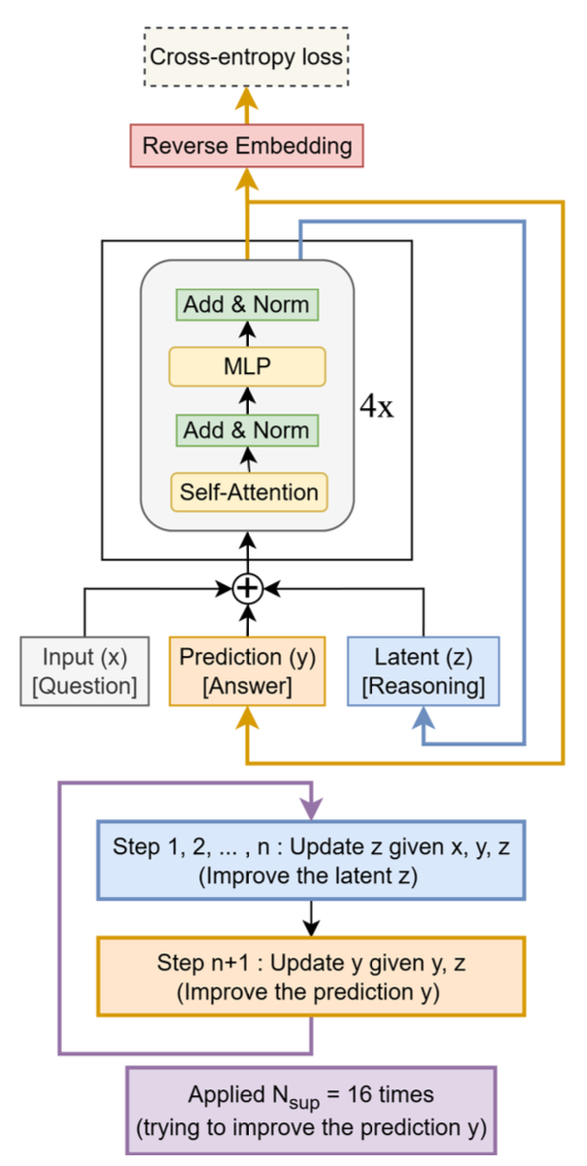
How TRM Works
Recursive Refinement
1. Start with Initial Guess
Embed input grid and initialize answer state
2. Recursive Loop
Update internal "reasoning" state z, then update answer y
3. Deep Supervision
Learn to improve at every step, not just final output
Like humans: draft, revise, revise... final answer

Slide 12
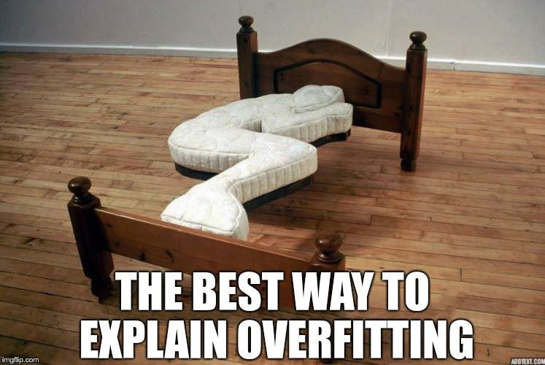
The Hidden Limitation
How does TRM know which transformation to apply?
Implications:
Answer: puzzle_id embedding
Each task gets a unique learned embedding vector fed to the model along with the input grid.
Transformation rules memorized during training
Cannot handle truly novel tasks
Only works on tasks seen during training
Not actual few-shot learning
At Test Time:
Model receives: input grid + puzzle_id
Model does NOT receive: demonstration pairs!
Rules are encoded in embedding weights
The model memorizes tasks, it doesn't infer rules from demonstrations!

Slide 13
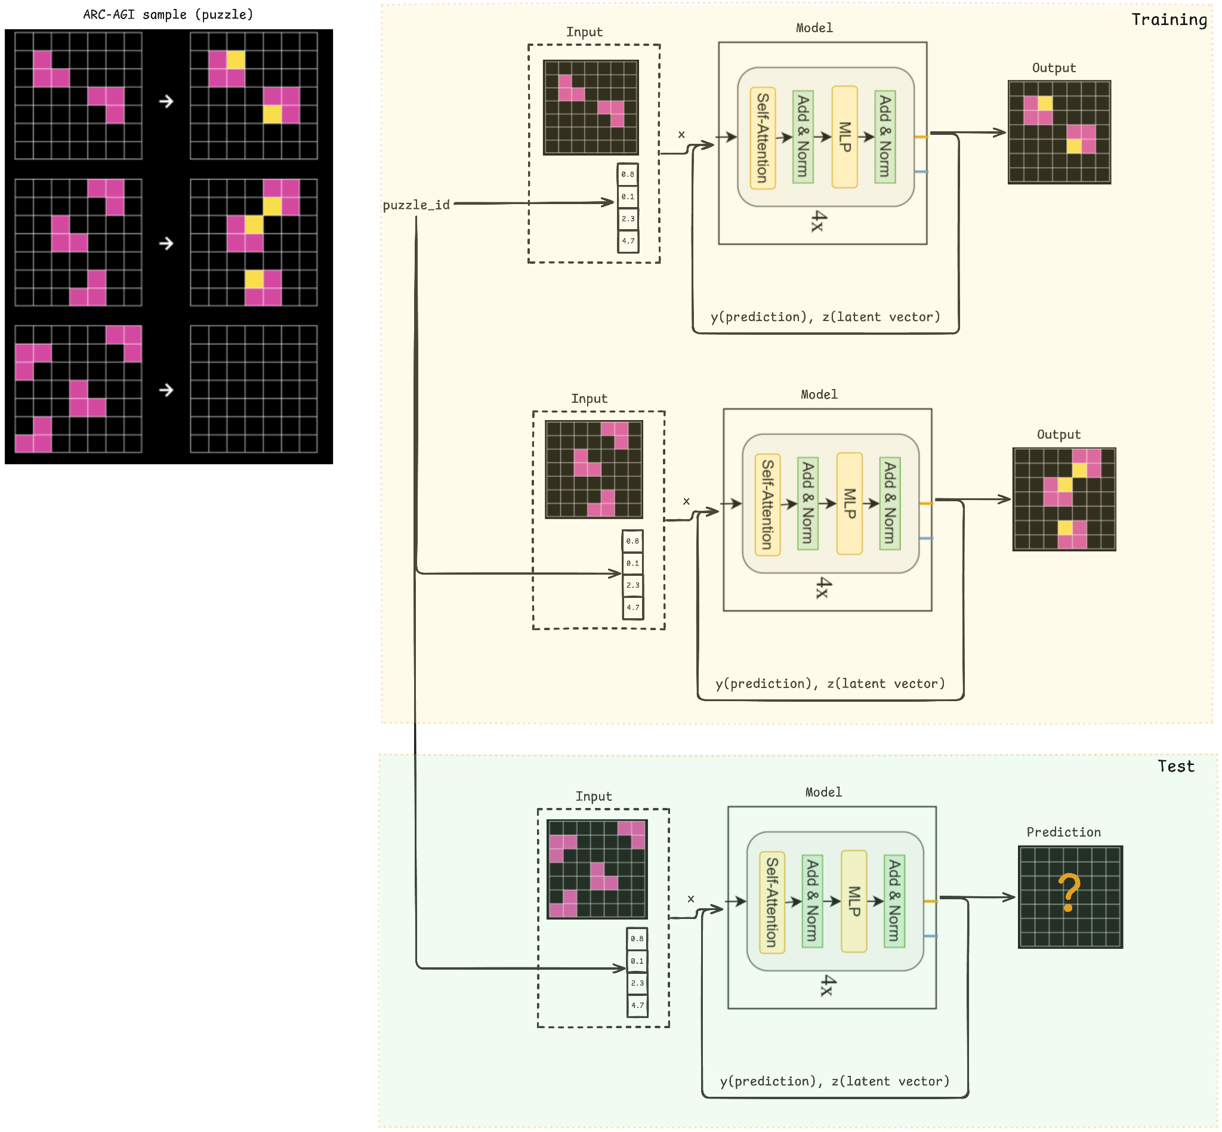
Memorization
TRM Training and Test Procedure
Training Phase
See demonstrations for all tasks
Learn puzzle_id embeddings
Rules encoded in embedding weights
Test Phase
[Insert trm.png]
TRM architecture diagram showing
puzzle_id embedding flow
Only puzzle_id + single input grid
NO demonstrations provided!
Must have seen task during training
Model can only solve tasks whose demonstrations it saw during training
Figure: Demonstrations are not fed to the model at test time

Slide 14
Empirical Evidence
ARC Prize Foundation Analysis
Interpretation
Most capability comes from memorization
Only ~10% from "true" generalization
Deep supervision accounts for much of the benefit
Experiment: Train HRM only on evaluation tasks
Normal training (800 tasks)
41%
31%
Conclusion: This violates ARC's intended few-shot paradigm. The model doesn't truly learn from demonstrations.
Eval-only training (400 tasks)
Note: This is not "cheating" - test outputs are never seen. But it's not what ARC was designed to measure.
Only 10 percentage points drop!

Slide 15
Can We Remove This Limitation?
Can we extend TRM to enable true few-shot generalization?
1
Replace puzzle_id embeddings with a demonstration encoder
2
Learn to extract rules from demonstrations, not memorize them
3
Evaluate on tasks never seen during training

Slide 16
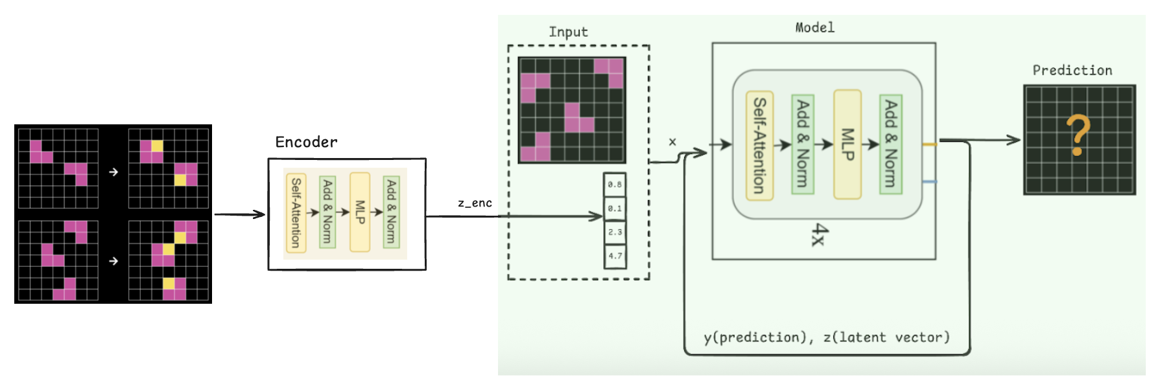
Few-shot learning

Slide 17
The Demonstration Encoder
Proposed Solution
Input
2-5 demonstration pairs (input grids, output grids)
Encoder Architecture
Output
Demo 1
Demo 2
...
Task context vector z_enc
v
Key Properties
Transformer Encoder
Same encoder for all tasks (training and test)
No task-specific learned parameters
Processes demonstrations at test time
Learns to "read" transformation rules
v
z_enc (task context)
The encoder extracts the transformation rule as a vector representation.

Slide 18
Why Variational?
Two Formulations
Loss Function
Standard Encoder
L = L_task + beta * KL(q(z|demos) || N(0,I))
demonstrations -> fixed vector z_enc
The KL term regularizes the latent space, encouraging structured representation of transformation rules.
Variational Encoder
demonstrations -> distribution (mean, variance)
Ablation planned: Compare VAE vs standard encoder to measure actual benefit.
Sample z_enc from learned distribution
Potential Benefits
Robustness to demonstration variations
Better generalization through regularization
Structured latent space

Slide 19
How It All Fits Together
Original TRM
Our Approach
Input Grid
Input Grid
+
+
puzzle_id embedding
z_enc from Encoder
(task-specific)
(from demos)
v
v
TRM Refinement
TRM Refinement
v
(unchanged)
v
Output Grid
Output Grid
Minimal change: Only the task context source changes. TRM mechanism stays the same.

Slide 20
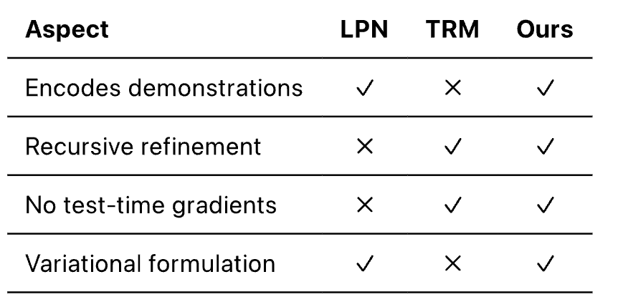
Related Work
Papers Extending HRM/TRM
Capability Comparison
TRM Analysis (Roye-Azar et al., Dec 2025)
Confirms puzzle_id dependency: replacing with blank token yields 0% accuracy
arXiv:2512.11847
Test-time Adaptation (McGovern, Nov 2025)
Fine-tunes TRM at test time; still requires gradient updates per task
arXiv:2511.02886
CompressARC (Liao, Dec 2025)
Trains from scratch per task using MDL; expensive (minutes/task)
arXiv:2512.06104
Demonstration Encoding Approach
Our Contribution
LPN: Latent Program Networks (Bonnet et al., Nov 2024)
Combines LPN's demo encoding with TRM's recursive refinement. Minimal change: replace puzzle_id with encoder. Single forward pass, no test-time search.
Encodes demos to latent distribution, variational formulation, test-time gradient search. No puzzle_id needed. NeurIPS 2025 Spotlight. 9.88% on ARC-AGI 1
arXiv:2411.08706 - Before HRM/TRM!

Slide 21
Experimental Design
Critical Constraint
Data Augmentation (following TRM)
Strict train/test task separation - evaluation tasks are never seen during training
Rotations (90, 180, 270 degrees)
Reflections (horizontal, vertical)
Color permutations
1000 augmentations per task
Data Split
Training tasks (ARC-AGI-1)
400
ConceptARC tasks
160
Training Procedure
Total training
560
Sample demonstration subsets
Encode demonstrations to get z_enc
Predict outputs for held-out examples
Evaluation tasks
400 (unseen)
The strict separation ensures this is a true test of few-shot generalization.

Slide 22
Technical Setup
Implementation
Evaluation Metrics
Framework
Pass@1 accuracy
Primary
PyTorch
Pass@2 accuracy
Secondary
Encoder Architecture
Planned Ablations
Attention-based (handles variable # of demonstrations)
Variational vs. standard encoder
Encoder capacity variations
KL divergence (Do Gaussian properties matter?)
Base Model
Following TRM hyperparameters where applicable
Training
End-to-end: encoder + TRM jointly

Slide 23
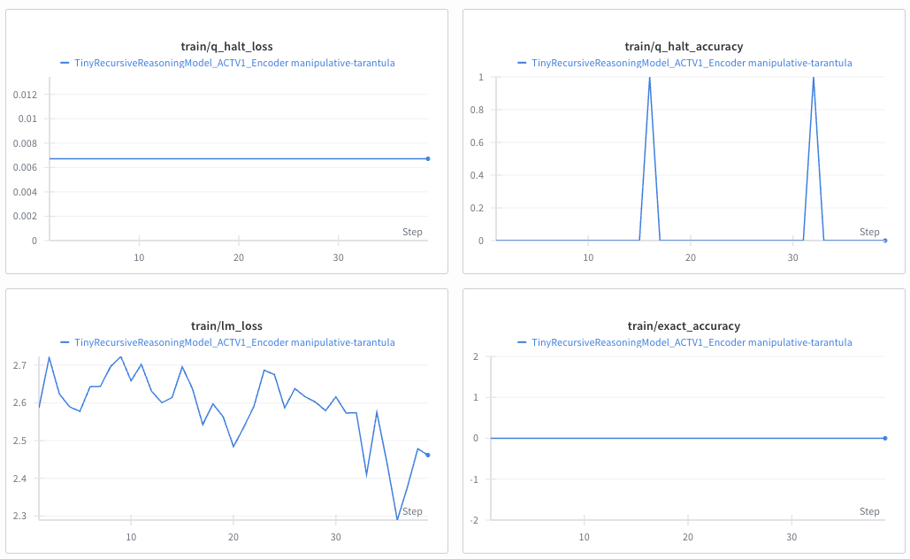
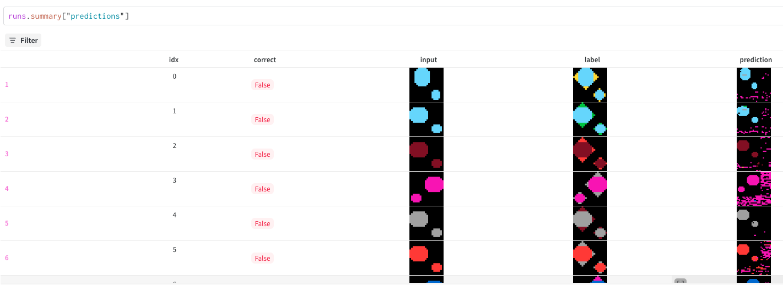
Current Status
Progress
Initial Experiments
ok
Baseline TRM understanding
ok
Encoder implementation (initial)
ok
Training infrastructure
...
Initial experiments running
Mode collapse
Constrastive loss
[Insert W&B screenshot or experiment status]
Note on Scope
Proof-of-concept project. Goal: test viability, not achieve SOTA.
https://wandb.ai/bdsaglam/ETRM
Training curves and preliminary results

Slide 24
Summary
ARC-AGI
Our Contribution
Tests abstract reasoning through novel visual puzzles. Requires true generalization, not memorization.
Demonstration encoder that processes demos at test time, enabling genuine few-shot generalization.
HRM/TRM
Approach
Tiny models (7M params) achieving impressive results (45% accuracy) through recursive refinement.
Variational encoder to extract transformation rules. Minimal change to TRM architecture.
The Limitation
Performance relies on puzzle_id embeddings - memorization, not true few-shot learning.

Slide 25
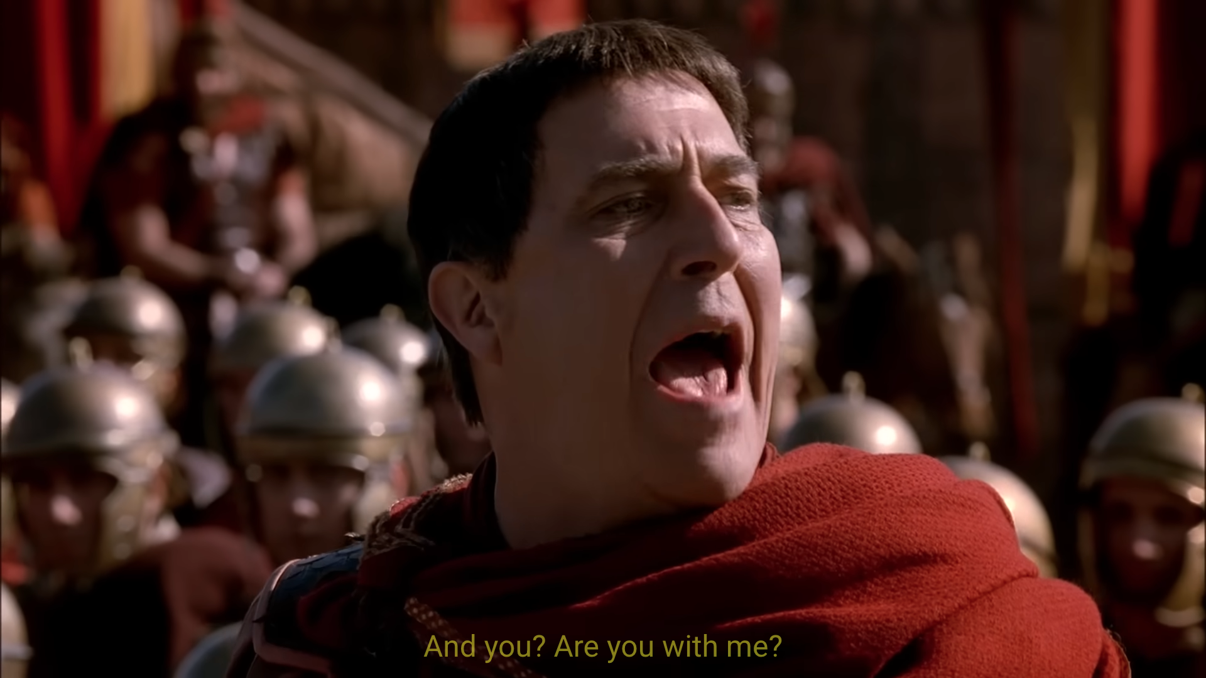
Questions?
Thank you for your attention
References
Chollet, F. (2019). On the Measure of Intelligence
Wang et al. (2025). Hierarchical Reasoning Model. arXiv:2506.21734
Jolicoeur-Martineau (2025). Less is More: TRM. arXiv:2510.04871
ARC Prize Foundation (2025). HRM Analysis

Slide 26
Q: Why not use demonstrations in original TRM?
Backup Slide
Answer
TRM doesn't process demonstrations at test time. It only takes a single input grid and predicts an output grid.
The "context" for each task comes from a learned puzzle_id embedding - a fixed vector assigned per task during training.
"Each puzzle... is given a specific embedding of shape [0, 1, D]"
Source: TRM Paper, Section 6
Key limitation: Since embeddings are learned per-task during training, they cannot exist for unseen tasks. The model has never seen the embedding for a new puzzle.

Slide 27
Q: How does encoder handle variable # of demonstrations?
Backup Slide
Answer: Transformer Self-Attention
Architecture
Each demo pair (input, output) is embedded as a token in a sequence
Demo 1
Demo 2
...
Demo N
v (variable length)
Self-attention computes pairwise relationships regardless of sequence length
Transformer + Self-Attention
v (pooling)
Final z_enc obtained via pooling (mean or CLS token)
z_enc (fixed size)
Inspired by Deep Sets and set-function Transformers

Slide 28
Q: What if the encoder just memorizes too?
Backup Slide
Strict Train/Test Separation
Why This Works
Training Tasks
Evaluation tasks are never seen during training - not even their demonstrations
ARC-AGI-1 training: 400
ConceptARC: 160
Total: 560 tasks
TRM: puzzle_id embeddings are learned per-task, cannot exist for unseen tasks
Evaluation Tasks
ARC-AGI-1 evaluation: 400
Our encoder: Learns a general function mapping ANY demos to z_enc
Completely unseen!
If encoder only memorized, it would fail completely on the 400 unseen tasks

Slide 29
Q: Expected performance?
Backup Slide
Realistic Expectations
Why Lower is Expected
True few-shot generalization is fundamentally harder than memorization
Encoder must learn to "read" rules from just 2-3 examples
Limited training data (560 tasks)
Small model capacity (7M params)
TRM (with memorization)
45%
on ARC-AGI-1 evaluation
Our Approach (true few-shot)
10-25%
Success criteria: If accuracy >5% on truly unseen tasks, approach is viable
likely significantly lower
Reference: CompressARC (zero pretraining) achieved ~20%

Slide 30
Q: Why TRM better than HRM despite smaller size?
Backup Slide
HRM
TRM
27M params | 40% accuracy
7M params | 45% accuracy
1. Full Backpropagation
2. Single Network
HRM uses 1-step gradient approximation. TRM backprops through all recursions. +30% on Sudoku
HRM: two networks (fL, fH). TRM: one network does both. Half params, better results
3. Fewer Layers
4. More Recursions
2 layers vs 4 layers. Less overfitting on small data (~1000 examples)
TRM: n=6, T=3 (42 depth) vs HRM: n=2, T=2 (24 depth). Deeper reasoning
5. EMA Weights
6. Simpler ACT
Exponential Moving Average prevents collapse. +8% improvement
Single forward pass vs two. No performance loss

Slide 31
Q: Why variational encoder?
Backup Slide
Benefits of VAE Formulation
Loss Function
1. Robustness
L = L_task + beta * KL(q(z|demos) || N(0,I))
Different demo subsets may encode same rule differently. Distribution captures uncertainty.
KL Term Effects
2. Regularization
Structured Space
KL term encourages structured latent space - similar rules map nearby.
Similar transformations cluster together
3. Handle Ambiguity
Smoothness
Ambiguous demos represented as broader distribution, not single point.
Small perturbations = gradual behavior changes
Trade-off: Posterior collapse risk. Will ablate VAE vs deterministic encoder.

Slide 32
Q: How is the model evaluated?
Backup Slide
Evaluation Metrics
TRM Evaluation Process
Exact Match (Primary)
Step 1: Augmentation
Output grid must match ground truth exactly - every cell correct. No partial credit.
Generate 1000 augmented variants of each task
Step 2: Solve All
Pass@1
Pass@2
Run model on each variant
Single guess
Two attempts (competition)
Task-level Averaging
Step 3: Inverse Transform
Each task may have 1-2 test inputs. Accuracy computed per input, then averaged.
Apply inverse augmentation to predictions
Step 4: Majority voting - select 2 most popular predictions as final answers

Slide 33
Q: ARC-AGI-1 vs ARC-AGI-2 differences?
Backup Slide
ARC-AGI-1 (2019)
Why ARC-2 is Harder
800 tasks (400 train, 400 eval)
1. Deliberate thinking: 2.7 min avg vs instant
Many solvable instantly by humans
Best AI: 75%+ (o3-preview)
2. Context-sensitive rules: Rules apply differently based on context
3. Multi-step reasoning: More transformations chained
ARC-AGI-2 (March 2025)
1120 tasks, more refined
4. Efficiency metric: Cost/task penalizes brute force
Avg human time: 2.7 min/task
Best AI: 16% (Grok-4) vs 60% human
5. Performance cliff: o3-low: 75.7% ARC-1 to 4% ARC-2!
Why We Focus on ARC-1
TRM/HRM baselines only exist for ARC-1. More established benchmark. Proof-of-concept first.

Slide 34
Q: HRM/TRM performance on ARC-AGI-2?
Backup Slide
ARC-AGI-2 Leaderboard
TRM Costs
Key insight: TRM with 7M params achieves comparable performance to frontier LLMs with trillions of parameters (<0.01% of the size).
This suggests recursive refinement is fundamentally different from scaling LLMs.

Slide 35
Q: How is cost per task calculated? Why TRM costs >$1?
Backup Slide
Cost Calculation
Why TRM Costs >$1 Despite Small Size
Submission Format
1. Training + inference coupled: Unlike LLM APIs, TRM trains from scratch on each run
Docker containers on standardized hardware
2. 1000x augmentation: Generates 1000 variants per task, solves all, majority votes
Formula
Total cost = Runtime x Hardware rate
Cost/task = Total cost / # tasks
3. 16 supervision steps: Each prediction runs Nsup=16 deep supervision iterations
HRM Example
4. Long runtime: Hours of GPU time for full evaluation
Runtime: 9h 16m for ~100 tasks
Total: $148.50 = $1.48/task
ARC Prize Note
"The relatively high cost of running HRM is due to training and inference being coupled in a single run."
TRM: $1.76/task (ARC-1), $2.10/task (ARC-2)
HRM: $1.48/task
ARC Prize 2025 target: $0.42/task

Slide 36
Q: What is Human Panel in ARC-AGI leaderboard?
Backup Slide
Methodology
Key Results
Study Setup
100% of ARC-AGI-2 tasks solved by at least 2 humans
400+ participants in San Diego (early 2025)
Tested on ARC-AGI-2 under controlled conditions
60% average human score on ARC-AGI-2
Same rules as AI: 2 attempts per task
Human Efficiency
Independent Validation
Show-up fee: $115-150 + $5/task incentive
Reported cost: $17/task
1729 crowd-workers (separate study)
Est. true efficiency: $2-5/task
76% avg on training, 64% on evaluation
98.7% of ARC-1 tasks solvable by at least one worker
Why it matters: Fair comparison point. Validates tasks are solvable. Shows accuracy vs cost tradeoff.

